Slide 1

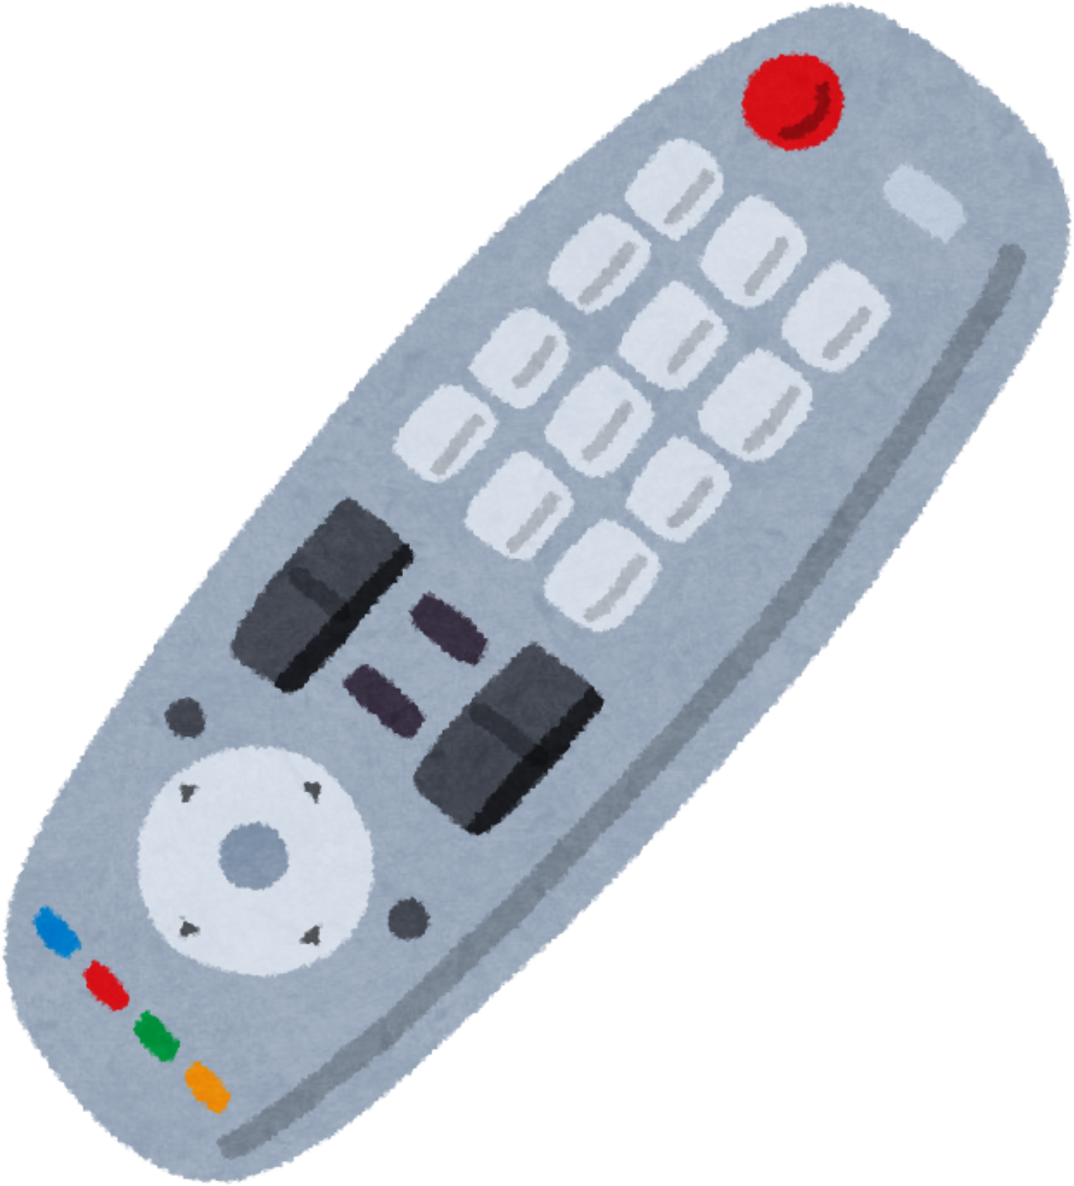

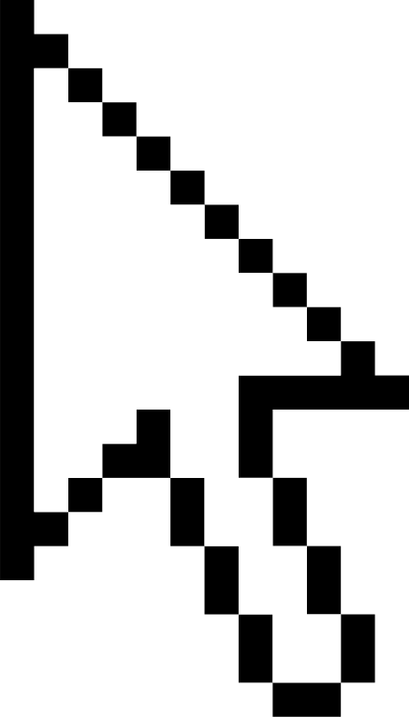
REMOTE
CONTROL
PESENTED TO: prof. Alaa Hamdy
1

Slide 2
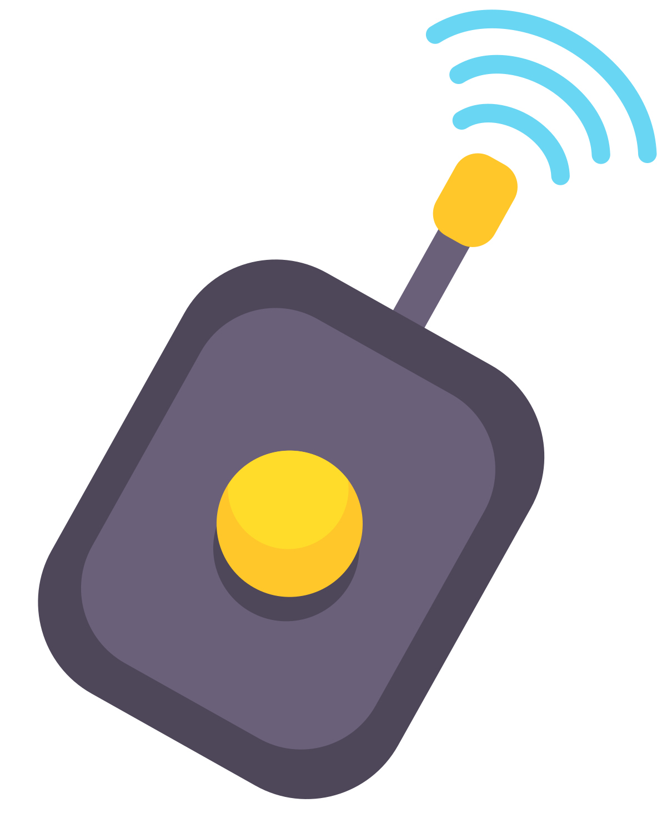

studio shodwe
OBJECTIVES
Design a simple IR remote control system using Arduino
Send unique commands for each button
Key idea: Using IR communication to control devices wirelessly.
2

Slide 3
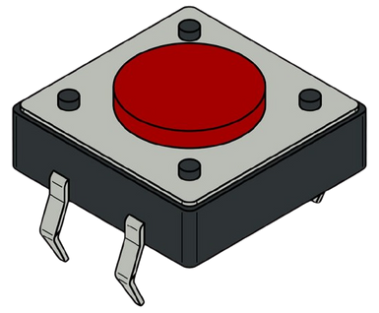

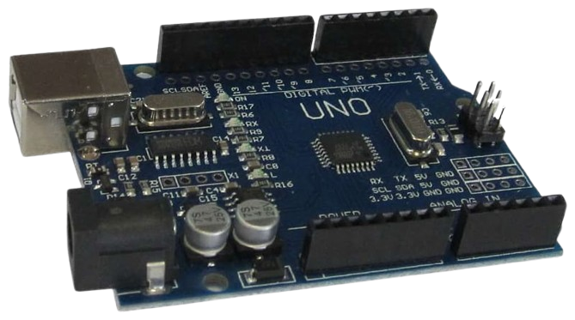

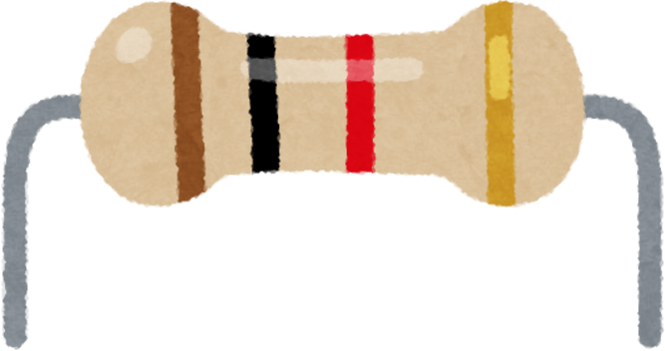

COMPONENTS (TRANSMITTER SIDE)
Transmitter side (Remote):
Arduino Uno
3 push buttons (B1, B2, B3)
IR LED (Infrared emitter)
Resistors
Wires / Breadboard
3

Slide 4
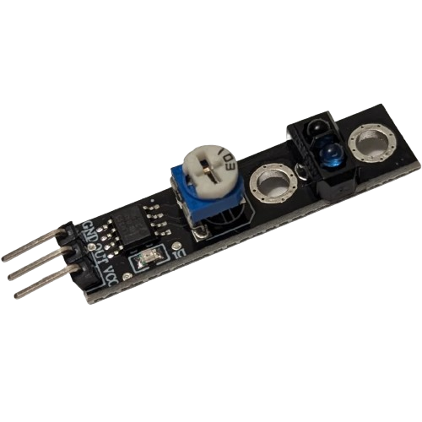
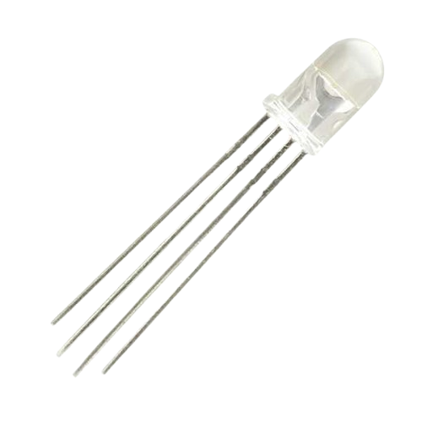
COMPONENTS
(RECEIVER SIDE)
Receiver side:
Arduino Uno
IR Receiver (KY-033)
RGB LED
Resistors
Wires / Breadboard
4

Slide 5

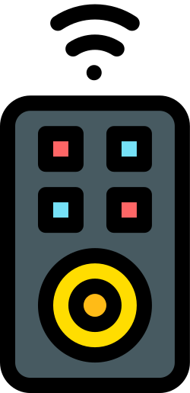
HOW TRANSMITTER WORKS ?
User presses a button on the transmitter.
Arduino reads which button is pressed.
Each button generates a unique pulse duration (time-based signal).
Signal is sent through an output pin.
The signal represents a command for the receiver.
Timing differences encode the command
5

Slide 6

HOW RECIEVER WORKS ?
Receiver Arduino monitors the input pin (sensor).
It measures the duration of the incoming signal (pulse length).
Uses threshold ranges to identify which button was pressed.
Maps pulse duration to a specific command (Decoding).
Activates the corresponding LED color.
Unknown signals are ignored and printed to Serial.
6

Slide 7
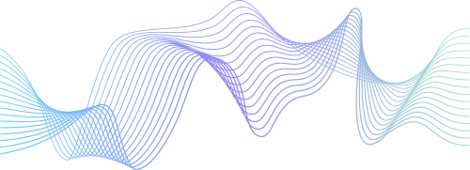
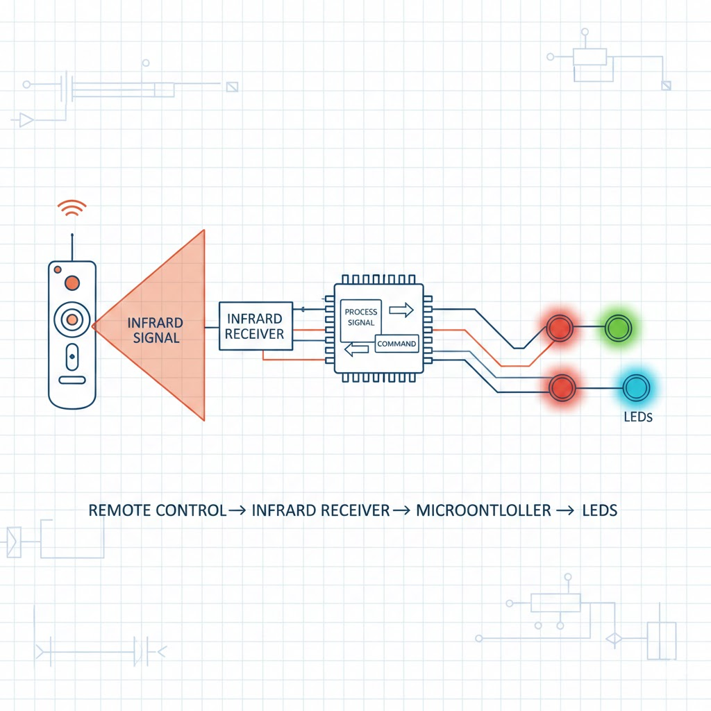
FLOW DIAGRAM
7

Slide 8

TRANSMITTER CODE
Three push buttons are connected to the Arduino.
Each button triggers a different timing-based signal.
LED is used to visualize the signal.
Serial messages help verify button presses.
System waits until button release before continuing.
if (digitalRead(5) == HIGH) {
Serial.println("B2");
digitalWrite(3, HIGH); delay(300);
digitalWrite(3, LOW); delay(300);
}
8

Slide 9

RECIEVER CODE
Input pin connected to sensor detects signal
Arduino measures how long signal stays LOW
Duration represents the command from transmitter button
Measured duration compared with predefined timing ranges
Corresponding LED turns on based on decoded command
Serial prints debug messages for verification purposes
Unknown signals are ignored and logged in Serial
if (t>80 && t<120) { digitalWrite(red,HIGH); delay(2000); digitalWrite(red,LOW); }
9

Slide 10
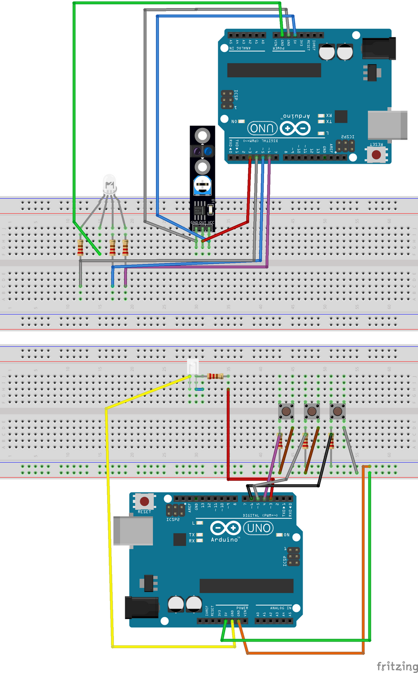
SIMULATION (REMOTE CONTROL)
Transmitter
Reciever
10

Slide 11
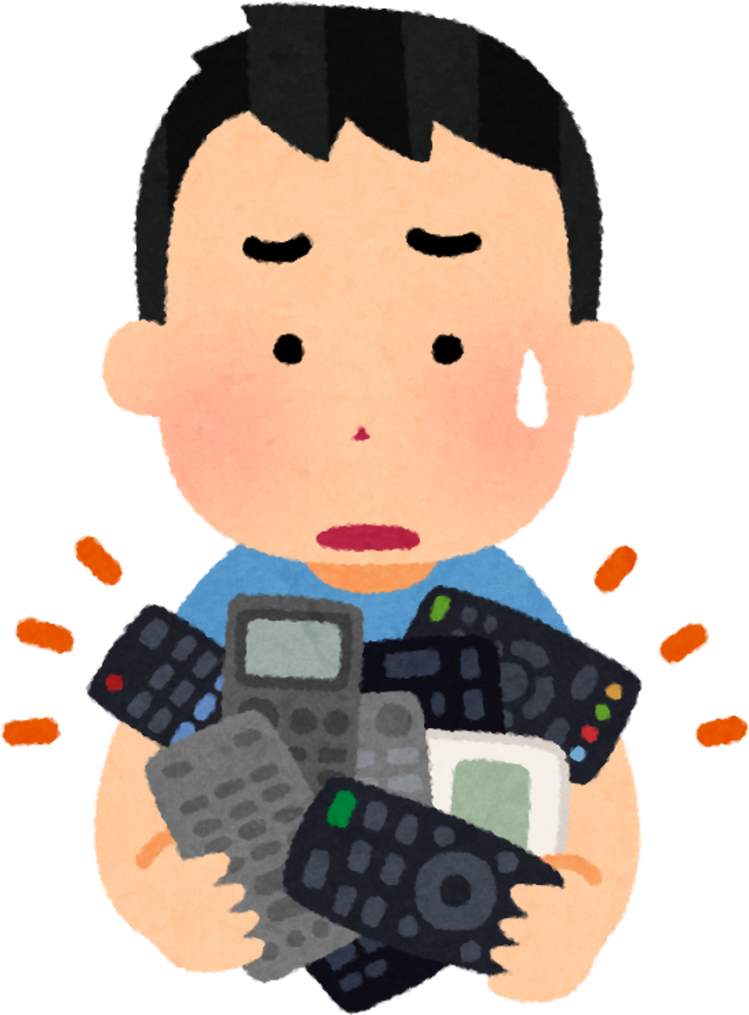
CHALLENGES & LEARNING
Challenge: Synchronizing timing-based signals correctly.
Learned: Arduino I/O, wiring, custom signal encoding/decoding.
11

Slide 12
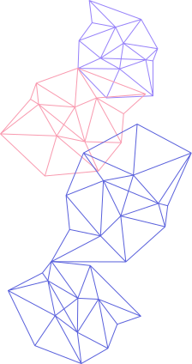
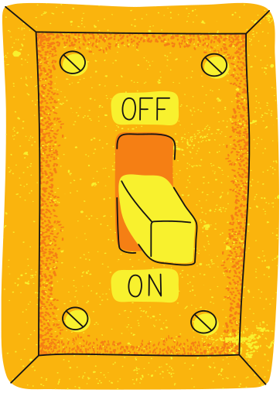
CONCLUSION
Simple remote control system works successfully.
Can be expanded to control other devices.
Demonstrates basic embedded communication concepts.
12

Slide 13



THANK
Any Questions ?
Nouran Hassan 2022/00062
YOU!
Roaa Khaled 2022/05885
13

